Slide 1


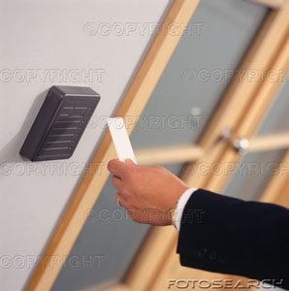
Smart Door Access System
B.Sc Project 2008

Slide 2
Smart Door Access System
Group Members
      Ali Hussein Ahmed
      Abdelrady Elagamy Abdelrady
      Nahed Nageib Foad
      Mariana Mounir Kelada
  Under supervision of
  Prof. Yousef B. Mahdy

Slide 3
What is Smart Door Access System?
System centralized on solving the problem of entrance control.
It facilitates entrance and Logging Operation in secured corporations.
It acts as Business process Improvement (BPI) of the current adopted manual system in organizations.

Slide 4
System Requirements
Support multiple doors
  Door Client computer near each door that has a card reader, a lock controller and a network connection.
  Central Doors Server computer that communicates with all Clients.
Reliability
  In case of electricity blackout: after the it is restored, all computers boot and run our programs automatically, so the system continues working unattended.
Security
  Clients must have a door Name and password to authenticated with server.
  Logging to door configuration must be by password that are encrypted and stored in a file.
  Client Configuration and settings are encrypted and stored in a file

Slide 5



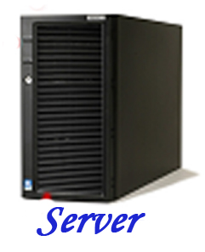


Door
Insert Barcode

Slide 6
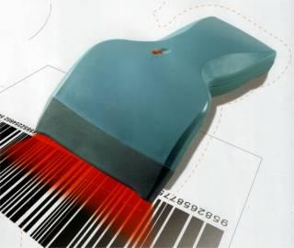
Barcode Reader
Problem
Card reader by default acts as keyboard, it writes the readied numbers in any area with focus.
so how to differentiate between keyboard and barcode input?
Also how to divert barcode input to specific area in application?

Slide 7
Card Reader
Solution
Register application for rawinput devices and obtain barcode directly from keyboard buffer.
After receiving input, processing it, and finally peek it from Message Queue.

Slide 8
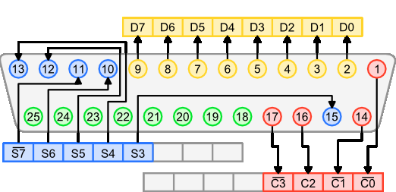
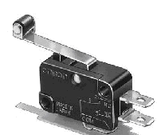
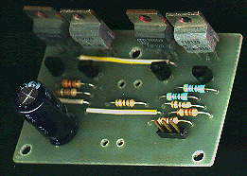
Door Lock
We design a small wooden model for door which connected to client machine via Parallel Port.

Slide 9
Client and Client Modes

Slide 10
1. Standalone mode
Standalone mode is the ordinary non-networked application mode. It is used to work during network unavailability.
it has its own list of allowed students sent to it form server.
each entrance event is logged in a temporary file, and sent later to the server once connection is available to the server.
Server receives this list and insert it in the Centralized database for debugging purposes.

Slide 11
Start
Barcode Allowed List
File Storage
Read Allowed Barcodes List
Wait Door
to Exit
Receive Barcode Number
Standalone Mode
Application flow
Open the Door
Search Barcode Number in List
Yes
No
Display Not Found Message

Slide 12
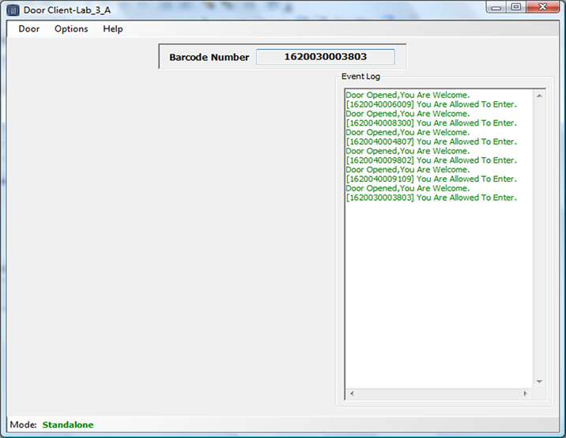

Slide 13
2. Connected to server application
Client applications requests data from remote server application, then analyze and present this data using the display capabilities of the client GUI.
Even if the data is moved or distributed to other database servers, the application continues to function with little or no modification.

Slide 14
Connect to Server Application
Sever Application Mode
Application flow
Read Barcode Number
Wait Door
to Exit
Send Barcode Number to server application
Open the Door
Receive Barcode Information upon barcode number
Barcode Number Found
Allowed to Enter Door
Yes
Yes
Display Received Information on Application
No
No
Display Not Found Message
Display Not Allowed message

Slide 15
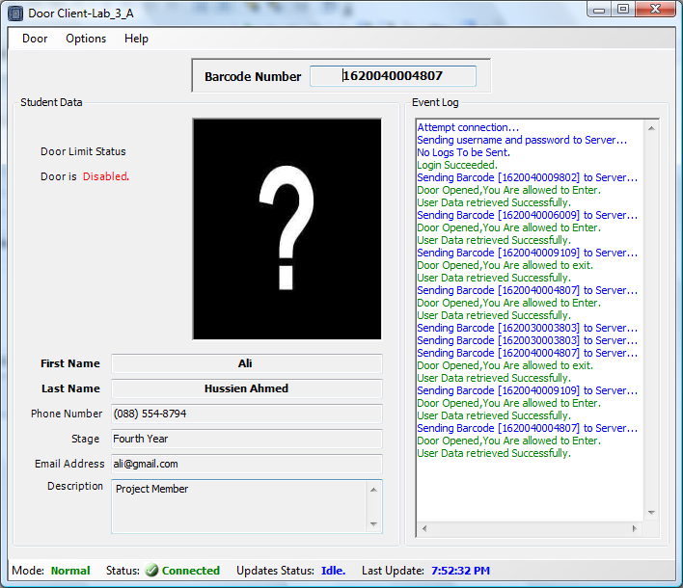

Slide 16
3. Connected to SQL server
Client applications connect to the Centralized database Via MS SQL Sever. they Send requests to the SQL server with stored procedures names.
After it is received, stored procedures executed in Server, and the results are returned to the client application.
Client can process the results and decide whether to open the door or not.

Slide 17
Connect to SQL Server
SQL Sever Mode
Application flow
Read Barcode Number
Wait Door
to Exit
Send Barcode Number to SQL server
Open the Door
If
Barcode Number Found
Allowed to Enter Door
Yes
Yes
Display Received Information on Application
No
No
Display Not Found Message
Display Not Allowed message

Slide 18
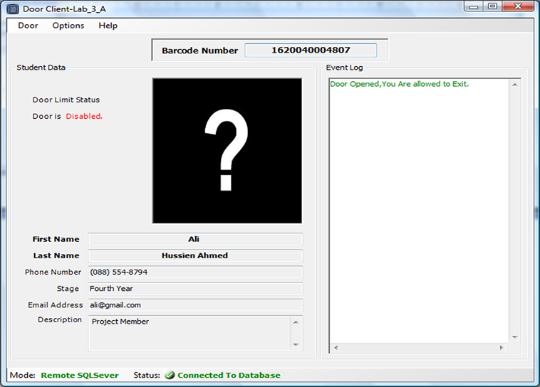

Slide 19
Server Application

Slide 20
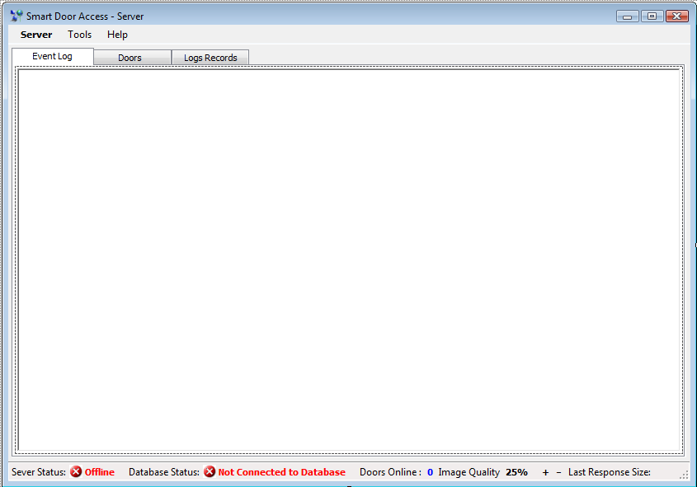
Application GUI

Slide 21
Server Functions
Full Enhanced Data Retrieval.
Data Packaging (includes quality Compression).
Entrance Logging.
The Continuous sending of Update Lists.
Clients Monitoring and controlling.
Receiving logs from clients.

Slide 22
Client In Operation

Slide 23
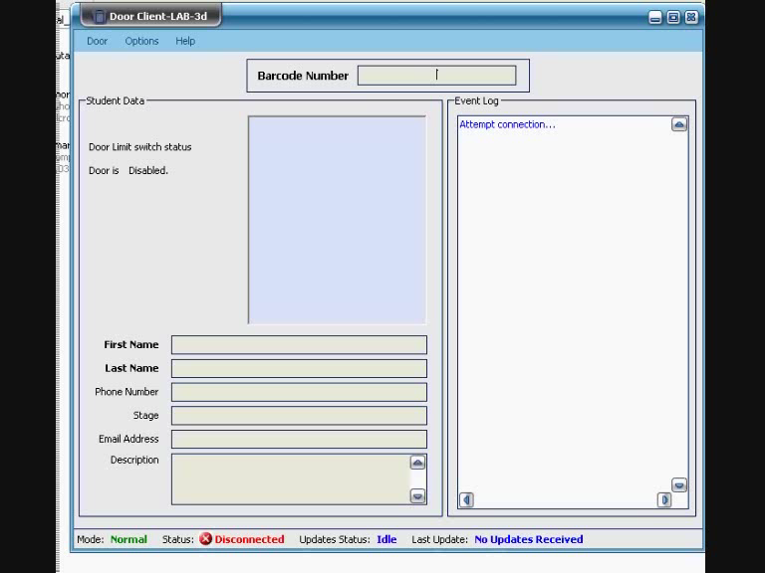

Slide 24
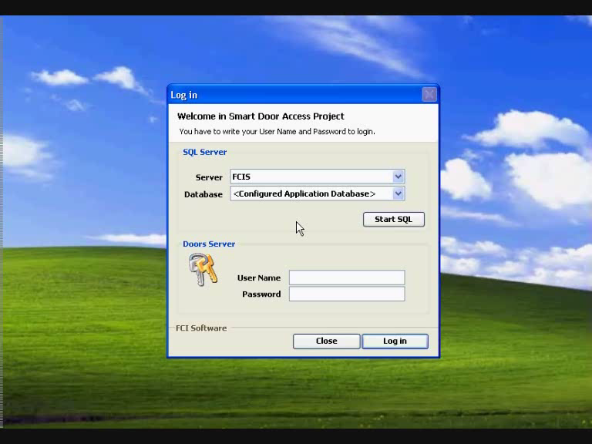
Client Monitor and Control

Slide 25
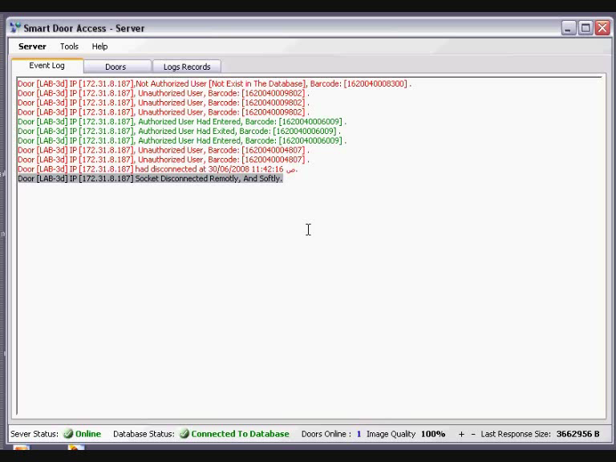
Image Quality Control

Slide 26
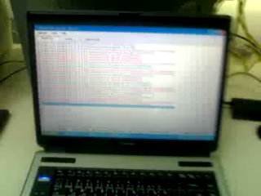
System and Door In Operation

Slide 27
System Administration
What Functions It Support:
  Add and modify and delete student info.
  Add , modify and delete door info.
  Assign access privilege to students via doors
  Show log data in Database.

Slide 28
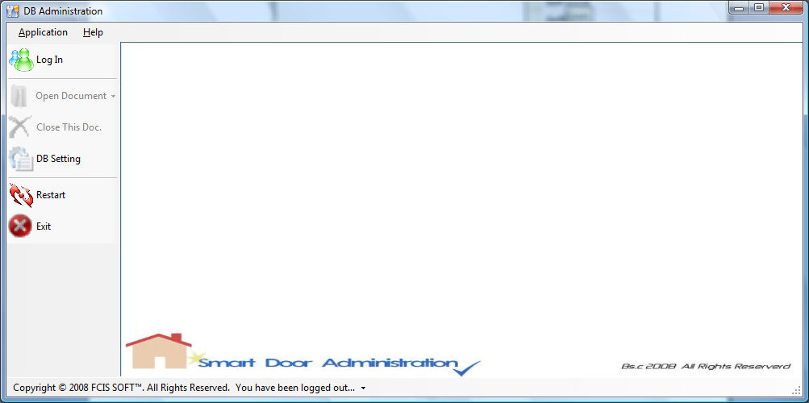
Administration GUI

Slide 29
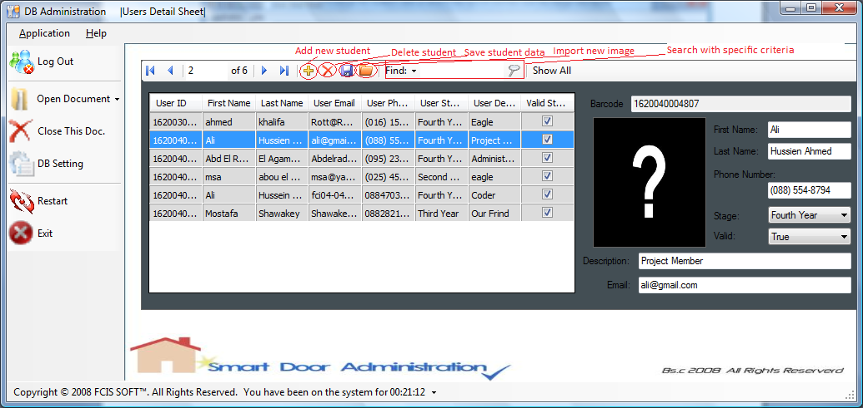
Students Detail Sheet

Slide 30
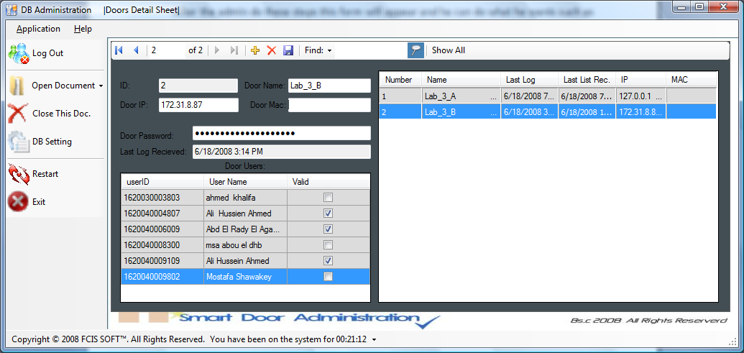
Doors detail sheet

Slide 31
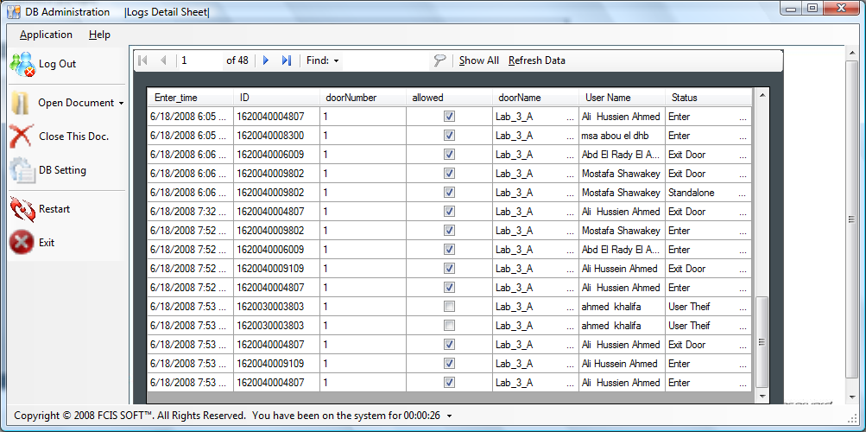
Logs Detail Sheet

Slide 32
Thank You

